Slide 1
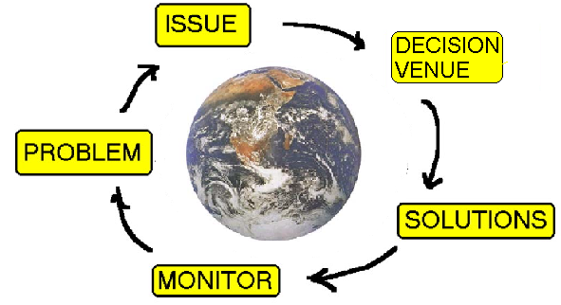
circle pure
Making Change
Notes:
Circle Pure Process

Slide 2
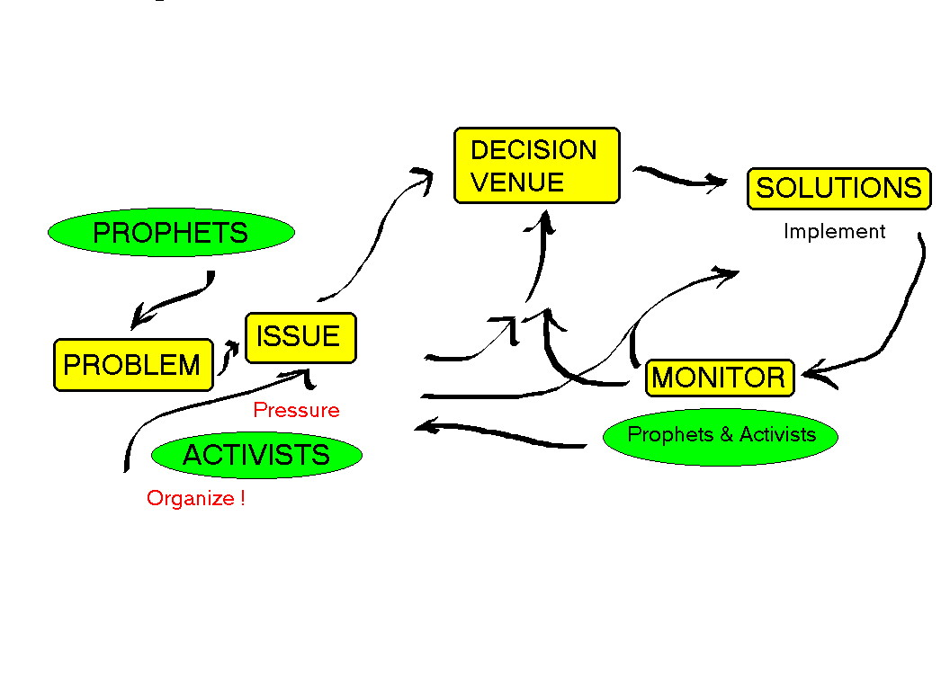
Pure Process 2
Making Change

Slide 3
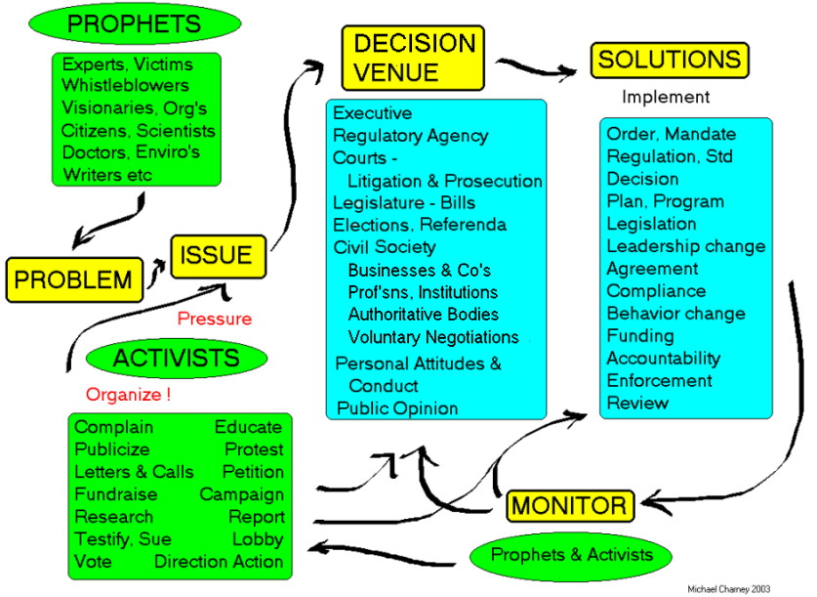
Full Process of Change

